Slide 1

Image Processing Course
FACIAL EXPRESSION RECOGNITION
Digital Image Processing Project
1
Youssef
Roaa
Hana
Marwa

Slide 2
Abstract
Facial expression recognition via digital image processing involves analyzing facial features to interpret emotions like happiness, sadness, and anger. It employs techniques such as face detection, feature extraction, and classification using machine learning algorithms. Advancements in this field have wide applications in human-computer interaction, healthcare, security, and psychology.
FACIAL EXPRESSION RECOGNITION
2

Slide 3
The preprocessing pipeline implemented in the code involves several key steps:
Methodology
1
2
3
✓ Image Enhancement:
✓ Data Loading and Inspection:
✓ Image Normalization:
Contrast Stretching: enhances image contrast by expanding intensity value ranges.
Unsharp Masking :sharpens images by using a blurred version to create an edge mask, boosting edge detail contrast.
• Images are loaded from a directory structure where each folder represents a label.
• The dataset consists of training and testing sets, clearly separated.
• Each image pixel intensity is normalized by dividing by 255 to convert values to a range of 0 to 1. This step helps in speeding up the convergence during model training.
FACIAL EXPRESSION RECOGNITION
3

Slide 4
The preprocessing pipeline implemented in the code involves several key steps:
Methodology
4
5
✓ Data Augmentation:
✓ Visualization:
• Techniques such as rotations, shifts, and flips are used to artificially expand the size of the dataset, which helps the model generalize better by training on varied data.
Functions are implemented to visualize the original and processed images for qualitative analysis.
FACIAL EXPRESSION RECOGNITION
4

Slide 5
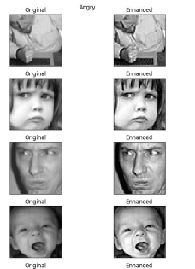
Methods used in pre-processing:
• Contrast Stretching
This method enhances the contrast of images by stretching the range of intensity values.
• Unsharp Masking
Applied to increase the sharpness of the images, this technique uses a blurred version of the image to create a mask of the original and enhances the contrast of edge details.
FACIAL EXPRESSION RECOGNITION
5

Slide 6
Methodology
1
2
3
✓Feature Extraction
✓Classification
✓ Clustering
Feature extraction in facial expression recognition condenses raw facial data into key characteristics, enhancing emotion classification accuracy and efficiency.
Classification in digital image processing labels images or regions based on visual features. In facial expression recognition, it identifies emotions like happiness or sadness in facial images using machine learning algorithms.
Clustering in digital image processing groups similar pixels or regions, assisting in tasks such as image segmentation and object recognition.
FACIAL EXPRESSION RECOGNITION
6

Slide 7
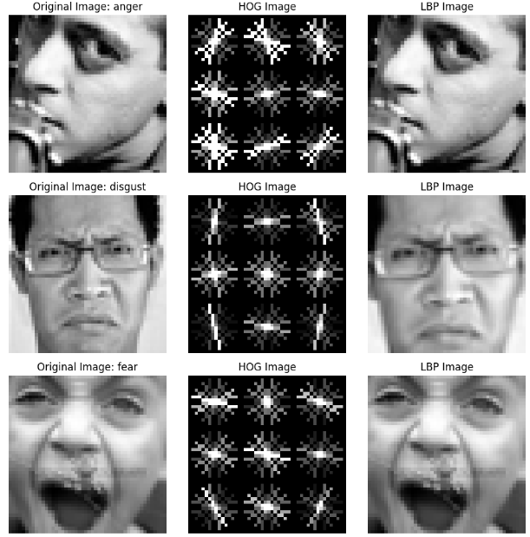
Feature Extraction methods used are:
Histogram of Oriented Gradients (HOG):
It computes the distribution of gradient orientations in an image, capturing shape and edge information. It's commonly used in object detection tasks.
Local Binary Patterns (LBP ):
It encodes local texture patterns by comparing the intensity of a central pixel with its neighbors, creating a binary pattern. It's effective for texture classification and facial expression analysis.
FACIAL EXPRESSION RECOGNITION
7

Slide 8
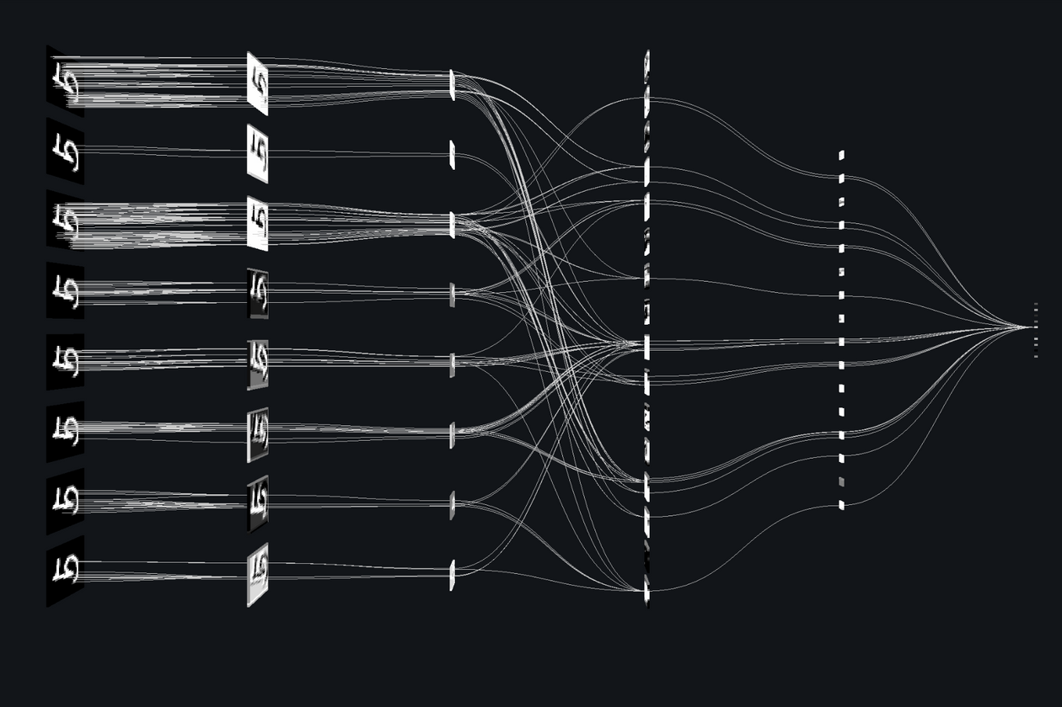
Classification methods used are:
Convolutional Neural Network(CNN )
CNNs are deep learning models used in image processing for tasks like image recognition. They automatically learn features from pixel data, making them adept at classifying images accurately. With layers like convolutional, pooling, and fully connected layers, CNNs capture complex patterns and spatial relationships within images.
FACIAL EXPRESSION RECOGNITION
8

Slide 9
CNN Activation Functions used:
1
2
✓ReLU
✓Softmax
•It introduces non-linearity by replacing negative values with zero, allowing the network to learn more efficiently and avoid the vanishing gradient problem.
Softmax normalizes the output of a network into a probability distribution across classes, ensuring their sum equals one. It's often used in classification networks' output layers to provide class probabilities.
FACIAL EXPRESSION RECOGNITION
9

Slide 10
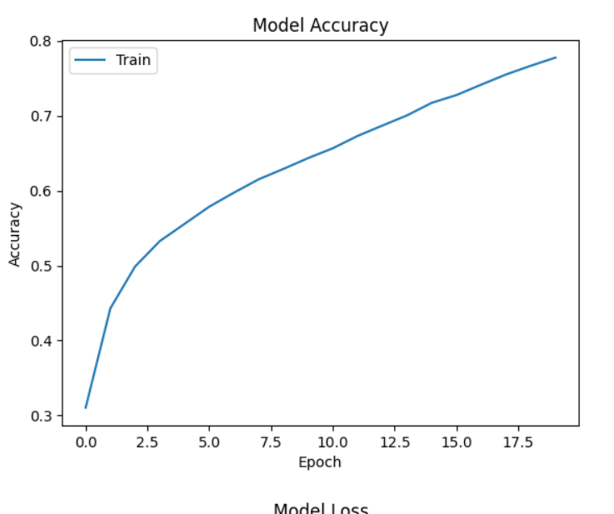
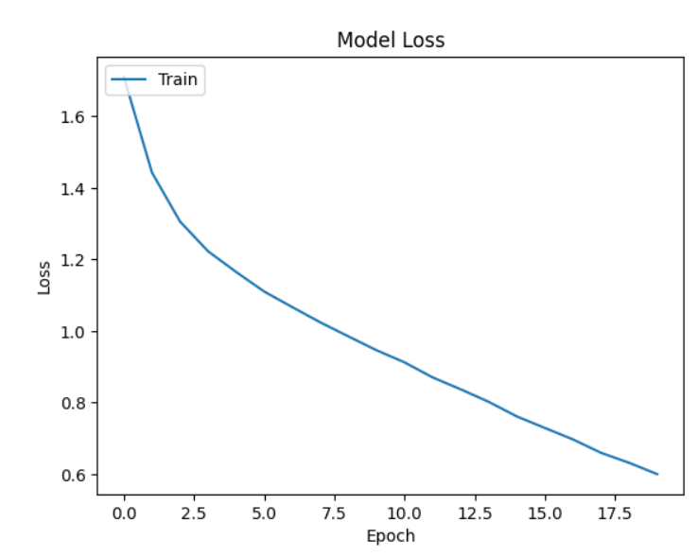
Model Accuracy
Model Loss
FACIAL EXPRESSION RECOGNITION
10

Slide 11
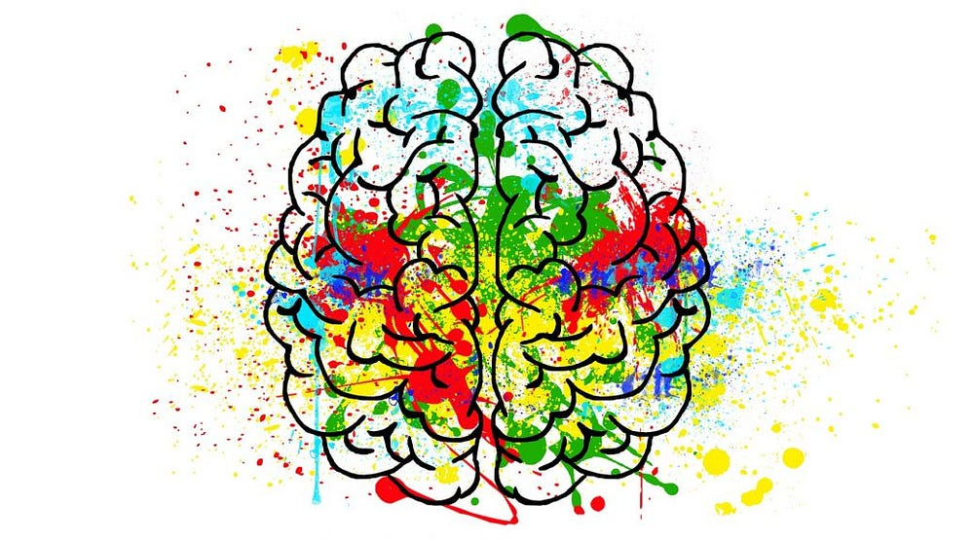
Classification methods used are:
Clustering
Clustering in digital image processing groups pixels based on similarity. Algorithms like K-means or fuzzy C-means assign pixels to clusters iteratively. This helps in segmenting images into regions, aiding tasks like object recognition or compression.
FACIAL EXPRESSION RECOGNITION
11

Slide 12
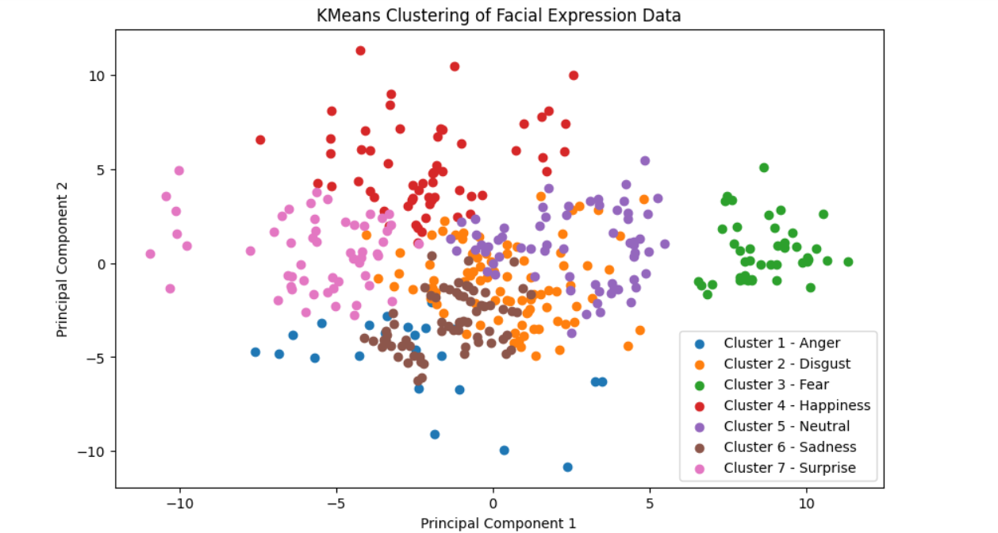
Clustering Method used:
✓K-Means
In digital image processing, clustering groups pixels based on similarity in features like color or intensity. It assigns pixels to clusters iteratively, updating centroids until convergence. Clustering is used for tasks like image segmentation and compression.
FACIAL EXPRESSION RECOGNITION
12

Slide 13

CONCLUSION
In summary, the face expression recognition project in digital image processing employs contrast stretching and unsharp mask for
pre-processing, followed by feature extraction using HOG and LBP. Classification is done using CNNs, while K-means clustering aids in grouping similar expressions. This integrated approach ensures accurate recognition and analysis of facial expressions in images.
FACIAL EXPRESSION RECOGNITION
13

Slide 14
Digital Image Processing
THANK YOU
FACIAL EXPRESSION RECOGNITION
Youssef
Roaa
Hana
Marwa

Slide 15
BY
YOUSSEF SARAYA 320210002
ROAA HATEM 320210003
HANA ADEL 320210014
MARWA AHMED 320210298
FACIAL EXPRESSION RECOGNITION

